Slide 1
Assignment 2
Objects, arrays and linked lists in memory
Linked lists manipulation
Data Structures, Fall 2018
TA: Marija Stanojevic

Slide 2
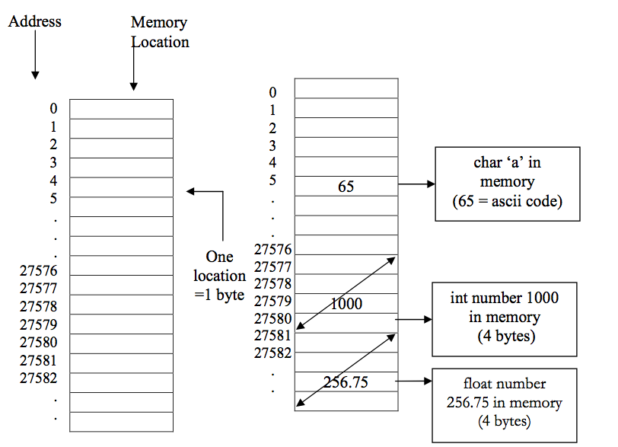
Primitive types representation in memory
char - 1 byte (= 8 bits)
short - 2 bytes (16-bits)
int - 4 bytes (32-bits)
long - 8 bytes (64-bits)
float - 4 bytes (32-bits)
double - 8 bytes (64-bits)
No cast from smaller to bigger or when equal (int -> float, short->long)
Need to cast from bigger to smaller (e. g. long -> short, double -> int)
[1] https://tex.stackexchange.com/questions/148778/how-to-draw-vertical-arrays-with-diagonal-arrows-to-represent-memory-in-tikz

Slide 3
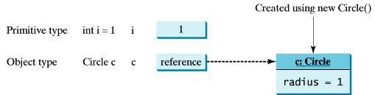
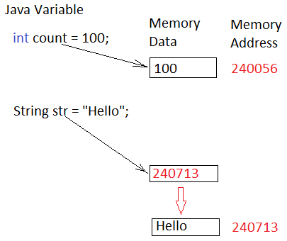
Primitive vs Object types in memory
When object is created (type starts with uppercase) two things are saved in memory:
Values of data fields (from previous slide)
Reference - address of the place where data is saved
When primitive types (start with lowercase letters) instances are created, only values are saved in memory
Primitive types are: int, short, double, float, long
Objects: String, Circle, Node, LinkedList, Stack,...

Slide 4
What is the size of reference in memory
What is the difference between 32-bit and 64-bit operating systems?
Addresses / references storage require 32-bits (4 bytes) in older 32-bit operating systems and 64-bits (8 bytes) in new operating systems.
Since we can store address in 64-bits, that means that we can address memory of size 2⁶⁴ bytes, because 1 row has one byte and we have 2⁶⁴ combinations to address a row.
In old computers, we could address only 2³² bytes = 2² * 2³⁰ = 4 * 1GB = 4GB of memory. In new computers, we can address 2⁶⁴ bytes = 2⁴ * 2⁶⁰ = 4 * 1EB = 16EB

Slide 5
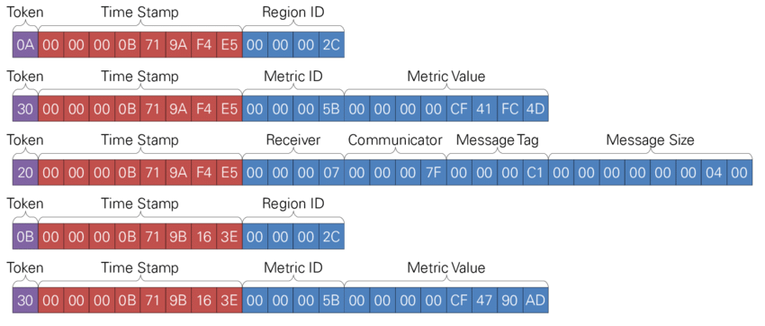
Objects representation in memory
Object Message takes 29 bytes to store data fields + 8 bytes to store reference to Message object
public class Message {
private char token;
private Date timeStamp;
private int receiver;
private int communicator;
private int msgTag;
private double msgSize;
// constructors
// getters & setters
// other methods
}
TimeStamp is reference to object Date, so it takes 8 bytes. Once timeStamp is initialized, additional 32 bytes are used to store its values
[2] https://www.researchgate.net/figure/represents-the-memory-representation-of-such-an-event-sequence-in-a-binary-encoding-All_fig21_284440851

Slide 6
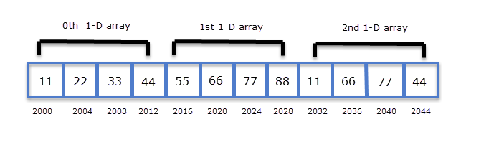
Arrays representation in memory
int [] ar = new int [3];
ar[0] = 5;
ar[1] = 4;
ar [2] = 10;
Arrays of objects would be of size N * k, where N is length of array and k is size of object in memory
Array of 10 messages takes 290 bytes to store data fields and 80 bytes to store references to the objects, so 370 bytes in total.
Message [] ar = new Message[10];
[3] https://overiq.com/c-programming/101/pointers-and-2-d-arrays/

Slide 7
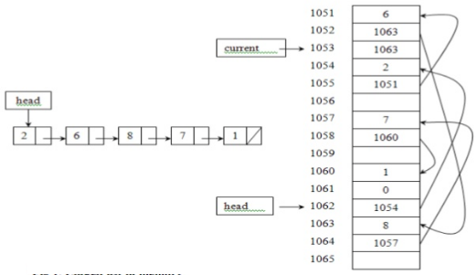
Linked lists in memory
Head is a reference that shows address of first node (1054).
In address 1054, we have value 2 and in next address reference to second node (1051).
In address 1051, we have value 6 and in next address reference to third node (1063).
If we define new reference to third node (current), it would also contain value 1063, ie. address of third node
current

Slide 8


Slide 9
Linked list - cases
Make sure your functions work for:
Empty list (head = null)
List with only one element (head.next = null)
List with few elements
If index/position is given as argument make sure your function works for:
negative index
index 0
index that is lower than number of elements in the list
index that is equal to the number of elements in the list
index that is equal to number of elements in the list + 1
index that is bigger than number of elements in the list + 1

Slide 10
Class Node
Node initialization:
Node x = null;
Node a = new Node(5);
Node b = new Node(10, null);
Node c = new Node(15, new Node(3));
When variable is just declared (e.g. x), just it’s reference is in memory, ie. 8 bytes.
When variable is declared and initialized (e.g. a, b, c), both reference and data are stored in memory: 8 bytes for reference + 12 bytes for Node data.
x = a; - copies reference/address of Node with value 5 into x, so now x and a both reference that Node.
private class Node {
private int data;
private Node next;
private Node(int data) {
this.data = data;
next = null;
}
private Node(int data, Node next) {
this.data = data;
this.next = next;
}
}

Slide 11
Go through the list
Add element at index
private Node head;
public void goThroughTheList(int item) {
Node current = head;
count = 0;
sum = 0;
belongs = false;
while (current != null) {
count ++;
sum += current.data;
current = current.next;
if (current.data == item) {
belongs = true;
}
}
}
Current.next in while condition means that last element is not accessed.
Don’t use it, except to add/remove element from the last position.
private Node head;
public boolean add (int item, int index) {
if (index < 0 || index > size()) {
return false;
}
if (index == 0) {
head = new Node(item, head);
return true;
}
Node current = head;
for (int i = 0; i < index-1; i++) {
current = current.next;
}
current.next = new Node(item, current.next);
return true;
}

Slide 12
Remove element by value
Remove element by index
private Node head;
public boolean removeByValue(int item) {
if (head == null) {
return false;
}
if (head.data == item) {
head = head.next;
return true;
}
Node current = head.next;
Node prev = head;
while (current != null) {
if (current.data == item) {
prev.next = current.next;
return true;
}
prev = current;
current = current.next;
}
return false;
}
private Node head;
public boolean removeByIndex (int item, int index) {
if (index < 0 || index >= size()) {
return false;
}
if (index == 0) {
head = head.next;
return true;
}
Node current = head;
for (int i = 0; i < index - 1; i++) {
current = current.next;
}
current.next = current.next.next;
return true;
}

Slide 13
java.api LinkedList
LinkedList is generic class. Data part of the nodes can be of any type.
add(E e) - adds to the end of the list
add(int index, E e) - adds to the position
addFirst(E e) - adds to the beginning
addLast(E e) - adds to the end of the list
clear() - removes all elements from the list
get(int index) - gets value at position
getFirst() - gets value from head
getLast() - gets value of the last node
remove() - removes first element of the list
remove(int index) - removes from position
removeFirst() - removes first element
removeLast() - removes last element
size() - returns size of the list

